Slide 1




TEAM GENZENIUS
EduRaksha Agent: Secure Verification
Enhancing Trust in Student Documentation through private and fraud-proof verification methods for eligibility assessment.

Slide 2




Verification Challenges
Understanding the complexities of student document verification processes
Current verification systems are plagued by privacy concerns, rampant fraud, and the inefficiencies of manual validation. These challenges lead to delays, inaccuracies, and a lack of trust in the system. It is essential to address these issues to ensure secure and reliable verification for all students.
2

Slide 3




Utilizing a decentralized approach enhances privacy and security, ensuring that student documents are verified without compromising sensitive personal information during the verification process.
Decentralized Verification
By implementing AI technologies, our system can automate and streamline the verification process, significantly reducing the time and resources typically required for manual validation of student eligibility.
AI Integration
The use of Zero Knowledge Proofs (ZKPs) enables our platform to provide trustless verification, minimizing the risk of fraudulent activities while maintaining the integrity of the verification process.
Fraud Prevention
Through Self-Sovereign Identity (SSI) Wallets, users are empowered to control their own verification data, enhancing accessibility and giving them the ability to manage who sees their information.
User Empowerment
3

Slide 4
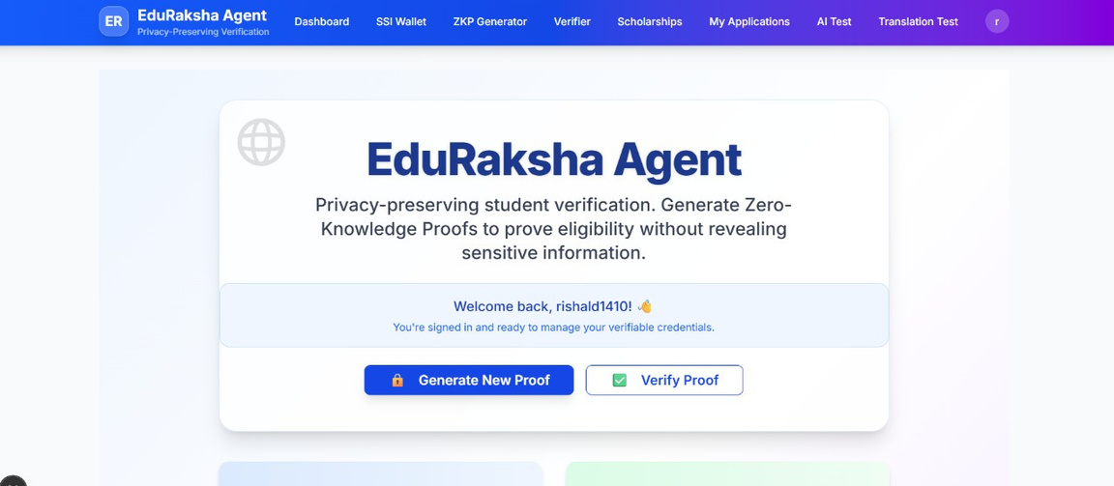
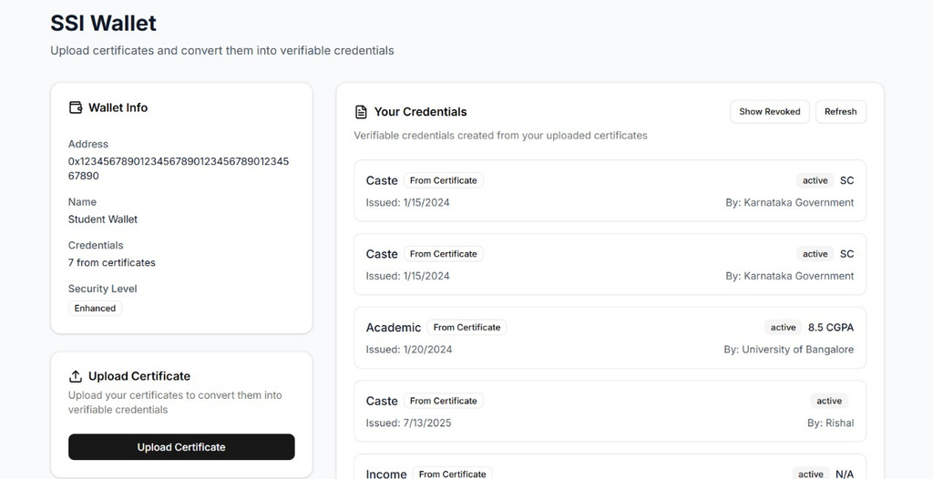
4

Slide 5
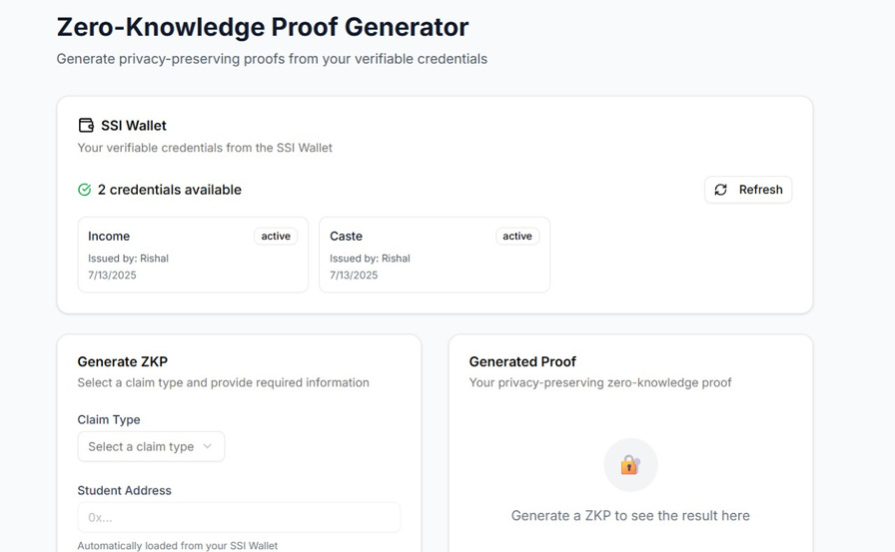
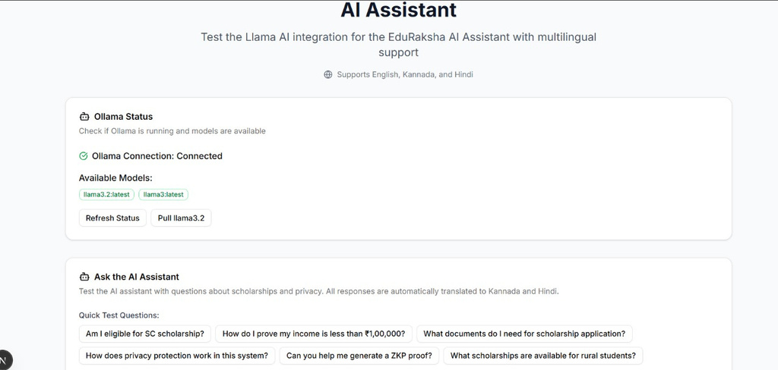
5

Slide 6



Long-Term Vision for EduRaksha:
Aim to set a global standard for decentralized, privacy-preserving verification.
Integrate with emerging technologies like IoT and quantum-resistant cryptography.
Expand to support credentials in healthcare, voting, and financial services.
Reduce fraud and administrative costs, unlocking significant economic value for education and social welfare.
6

